Slide 1
Disease Genes and Identification of Significant Variants
GDW2018
Slatteryjp@si.edu
Jill.Pecon.Slattery@gmail.com www.cornerstonegenomics.com

Slide 2
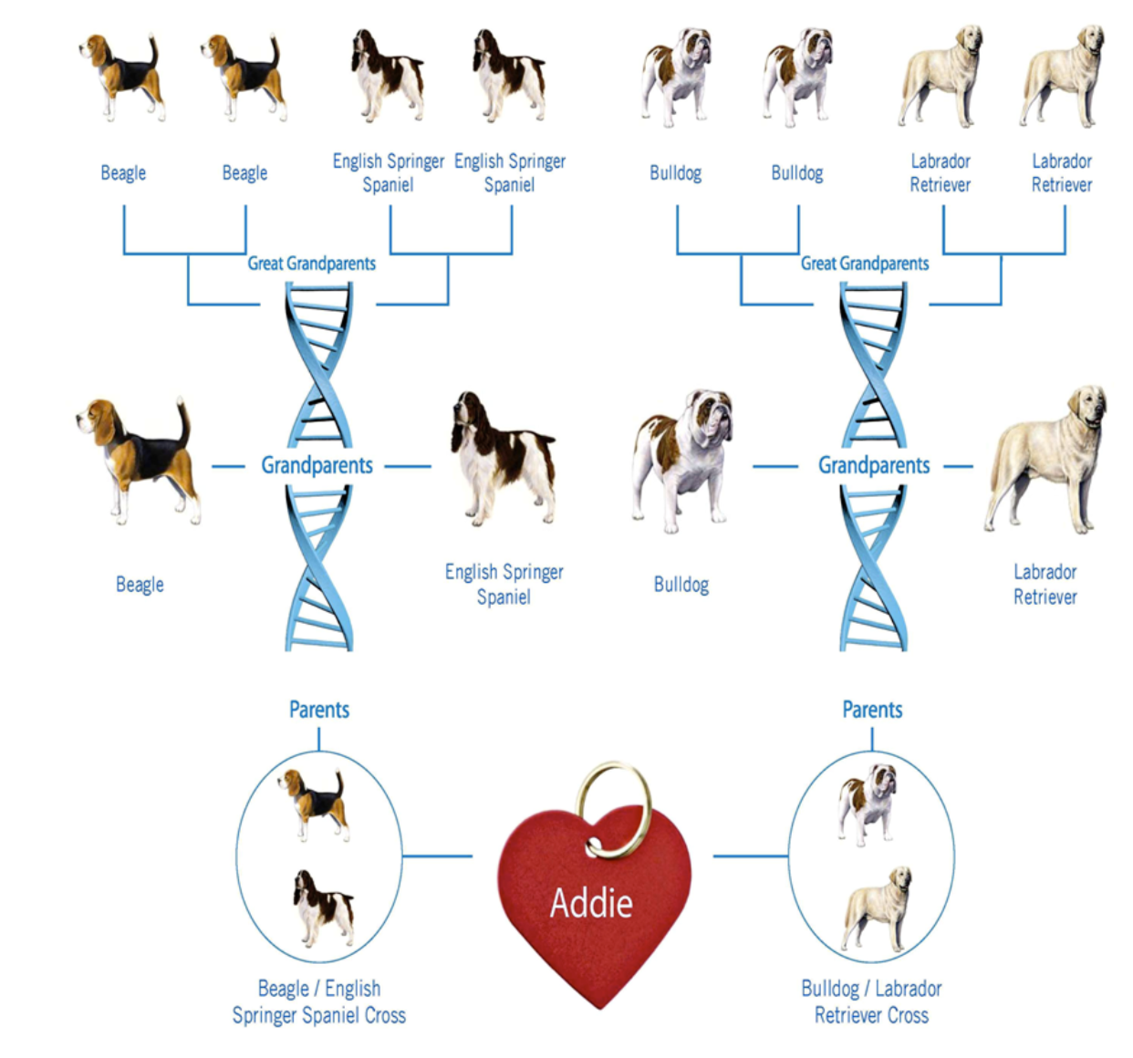


Applications and Accuracy of Whole Genome Variants: Examples with Ancestry
Fortune magazine 2015
Testing 2 different Ancestry kits for dogs
‘Problems with algorithms…...’

Slide 3
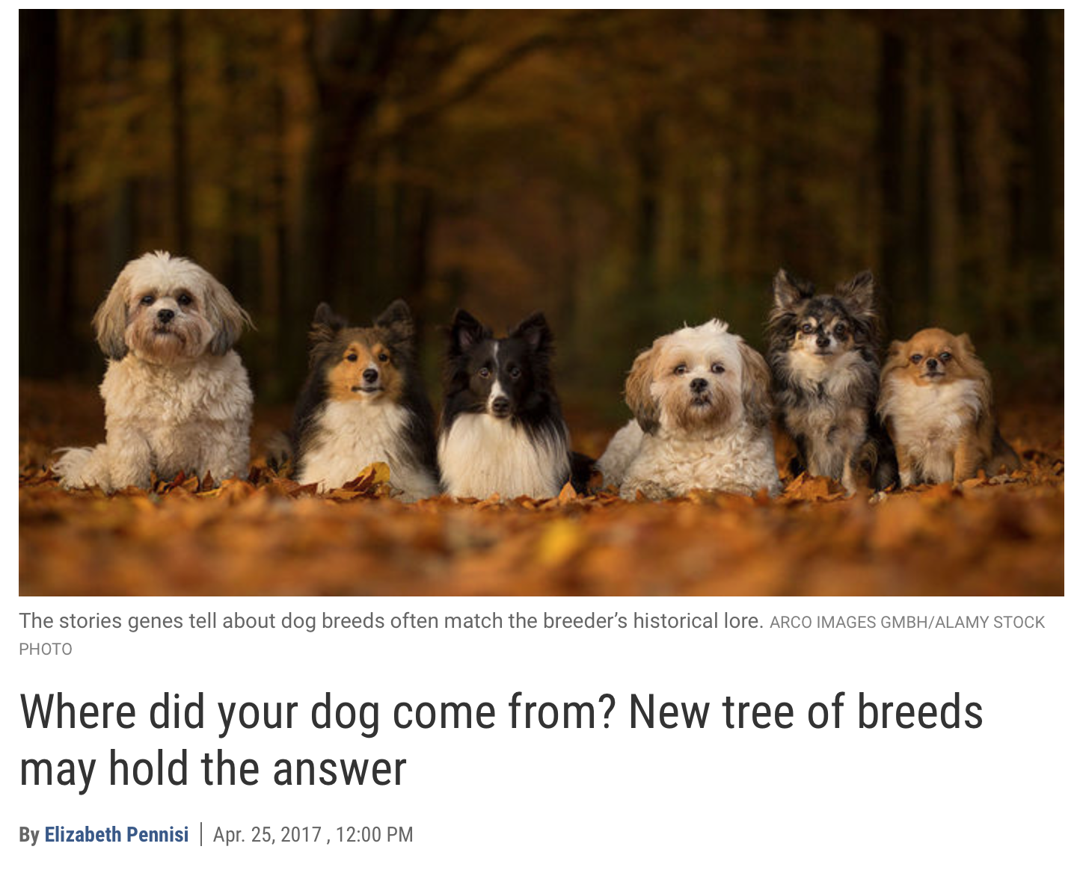

Slide 4
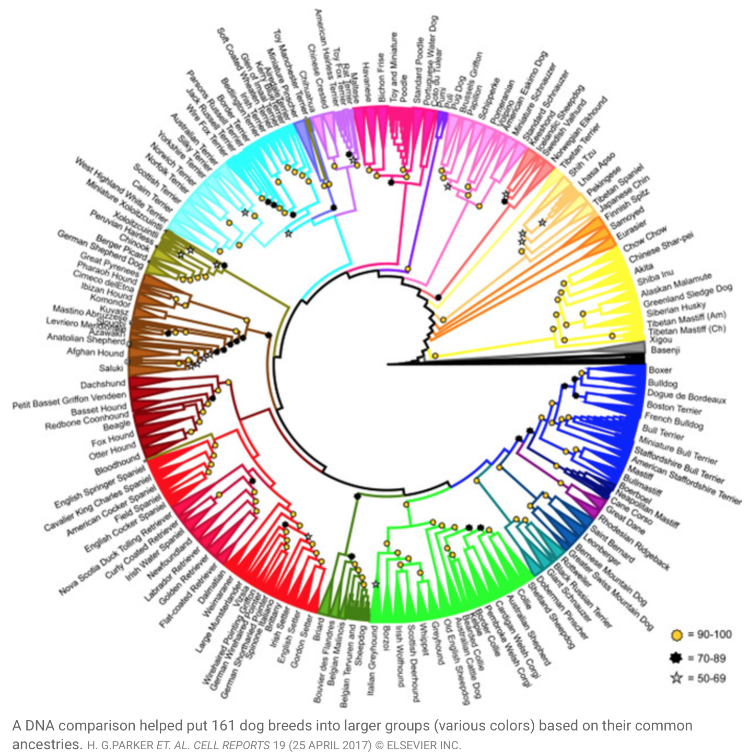
2017 Dog Breed Phylogeny
161 Breeds
23 Clades
150,000 SNPs
Notes:
23 clades of 161 breeds based 150,000 SNPs

Slide 5
Genomics Of Human Disease Variants: Good News And Bad News And How It Relates To Disease In Wildlife
Problem: One recent analysis of 406 published severe disease mutations observed in 104 newly sequenced individuals reported that 122 (27%) of these were either common polymorphisms or lacked direct evidence for pathogenicity.
Problem: Other studies have identified numerous alleged ‘severe disease-causing’ variants in the genomes of population controls.
Problem: In other cases, well-powered follow-up studies of high-profile reported mutations have cast serious doubts on initial reports assigning disease causality to sequence variants, but the vast majority of false-positive findings probably remain undetected.
24 APRIL 2014 | VOL 508 | NATURE | 469

Slide 6
Will These Human Biomedical Best Practices Work for Wildlife Disease?
Multiple unrelated families for rare monogenic conditions
(No)
1000’s to 10,000’s samples of ‘patients’ and ‘controls’
(Maybe-depends on Scale… taxa/pathogen)
Consortiums to gather, curate samples
(Why not!)
Pool cohorts guided by demography, population genetics, and phenotypes
(Yes)
For presumed monogenic diseases, multiple families (pedigrees), but if a de novo condition, analyze the parents, using hypothesis driven testing of genes.
(Yes, captive species)
Test hypotheses in genes known to be linked with phenotype (e.g. GO terms) or Systems Biology approaches
(Yes, comparative genomics, evolutionary genomics)
For cases and control studies based on whole exome: Bonferroni adjusted of 0.05/30,000 genes (or whatever the number of genes in organisms genome)
(Yes)

Slide 7
Human to Wildlife: How to identify causative variants within a gene linked with disease in Host Species
1) Association: the variant is significantly enriched in cases compared to controls.
2) Segregation: the variant is co-inherited with disease status within affected families and additional co-segregating pathogenic variants are unlikely or have been excluded.
3) Population frequency: the variant is found at a low frequency, consistent with the proposed inheritance model and disease prevalence, in large population cohorts with similar ancestry to patients.
4) Conservation: the site of the variant displays evolutionary conservation consistent with deleterious effects of sequence changes at that location.

Slide 8
Human to Wildlife: How to identify causative variants within a gene linked with disease in Host Species
5) Predicted effect on function: variant is found at the location within the protein predicted to cause functional disruption (for example, enzyme active site, protein-binding region).
6) Gene disruption: the variant significantly alters levels, splicing or normal biochemical function of the product of the affected gene. (in vitro verification)
7) Phenotype recapitulation: introduction of the variant, or an engineered gene product carrying the variant, into a cell line or animal model results in a phenotype that is consistent with the disease and that is unlikely to arise from disruption of genes selected at random.
8) Rescue: the cellular phenotype in patient-derived cells, model organisms, or engineered equivalents can be rescued by addition of wild-type gene product or specific knockdown of the variant allele.

Slide 9
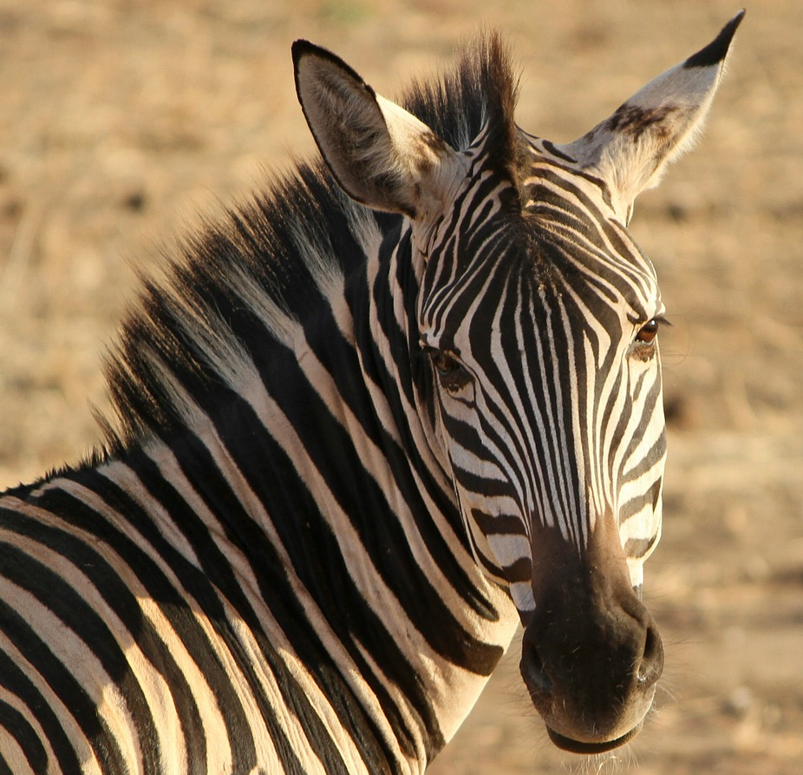
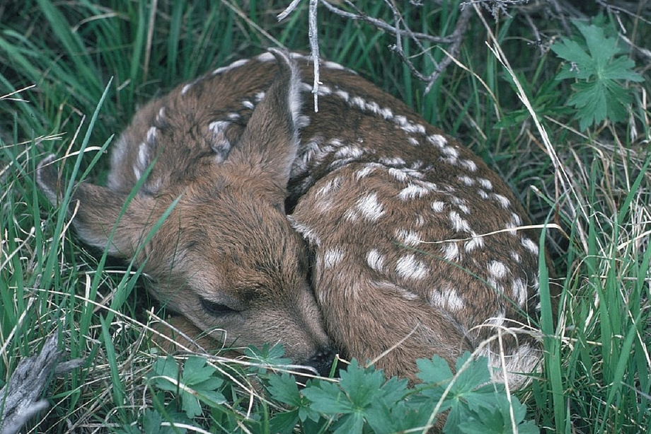
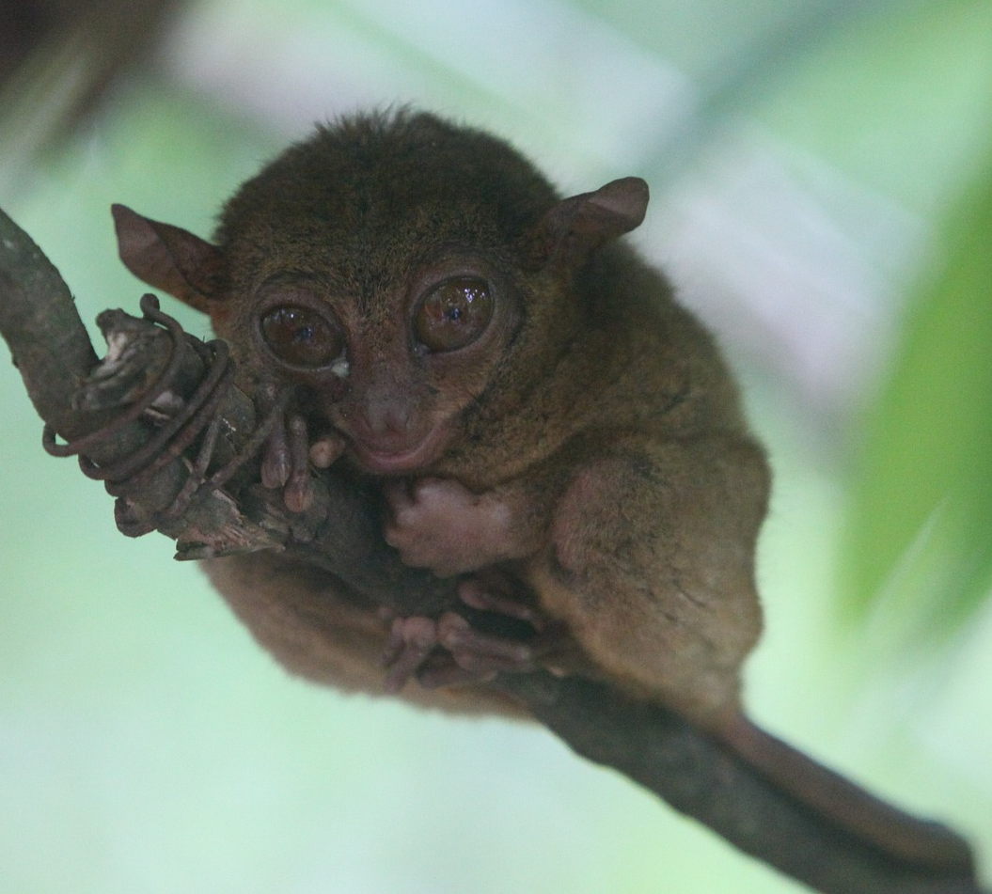
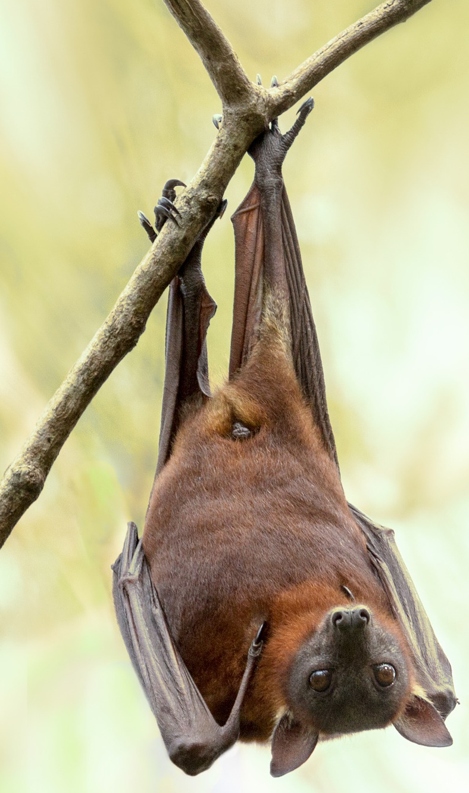
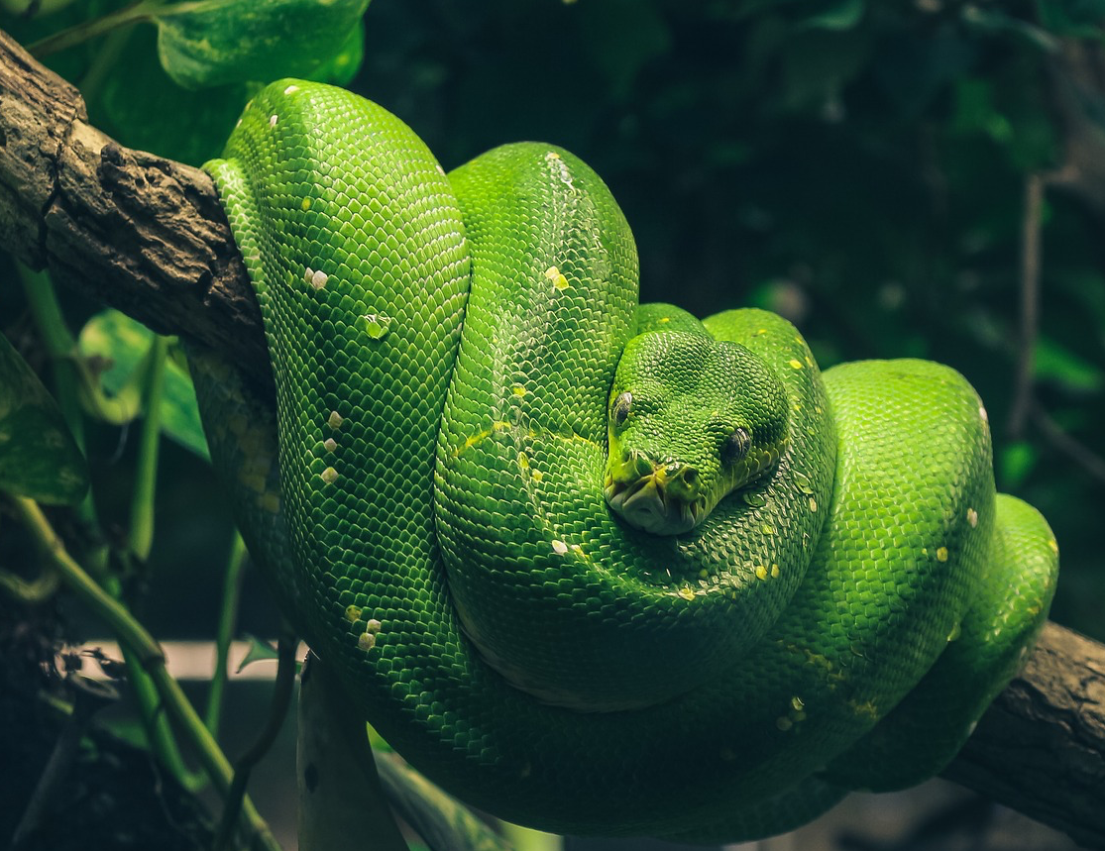
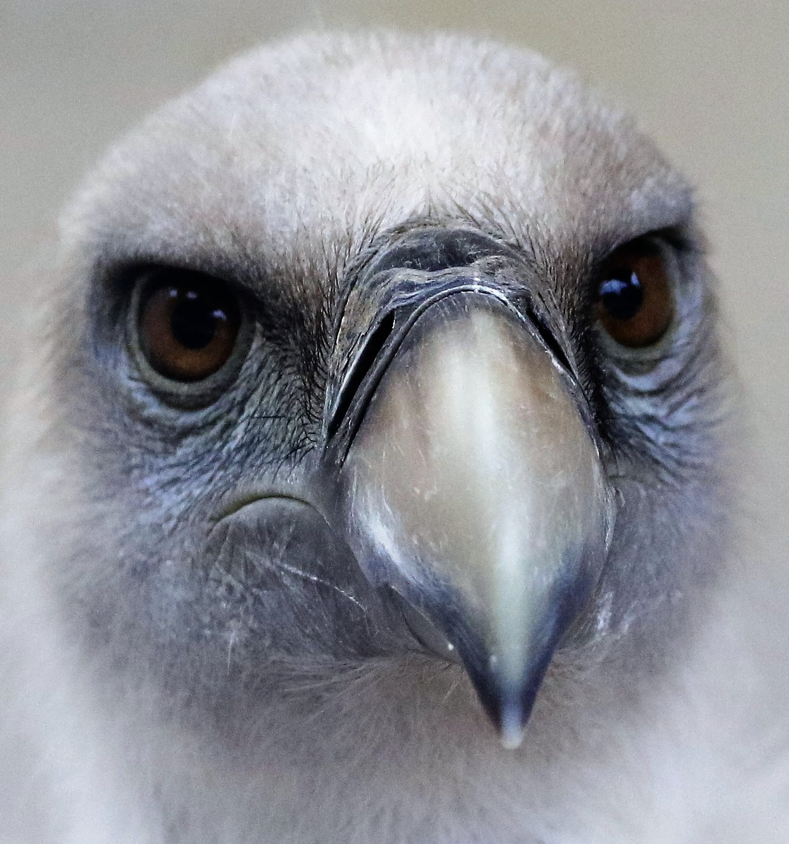
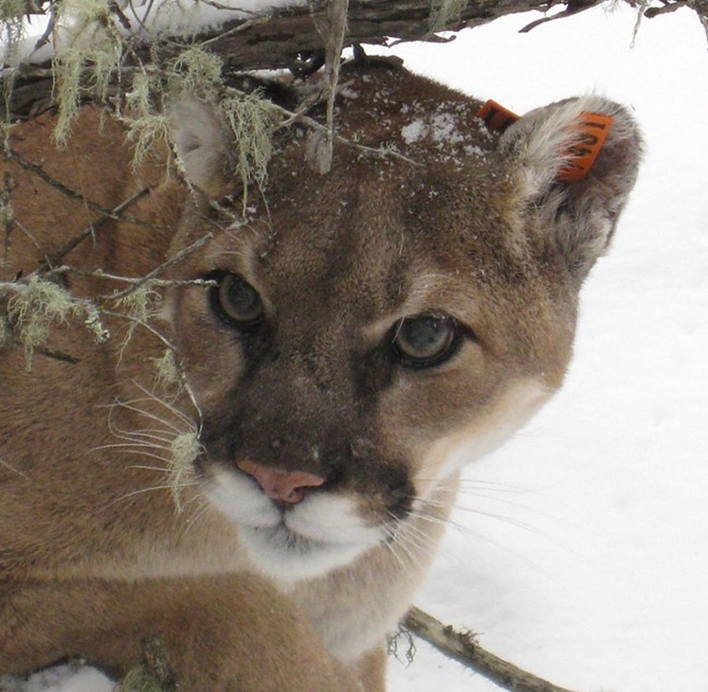
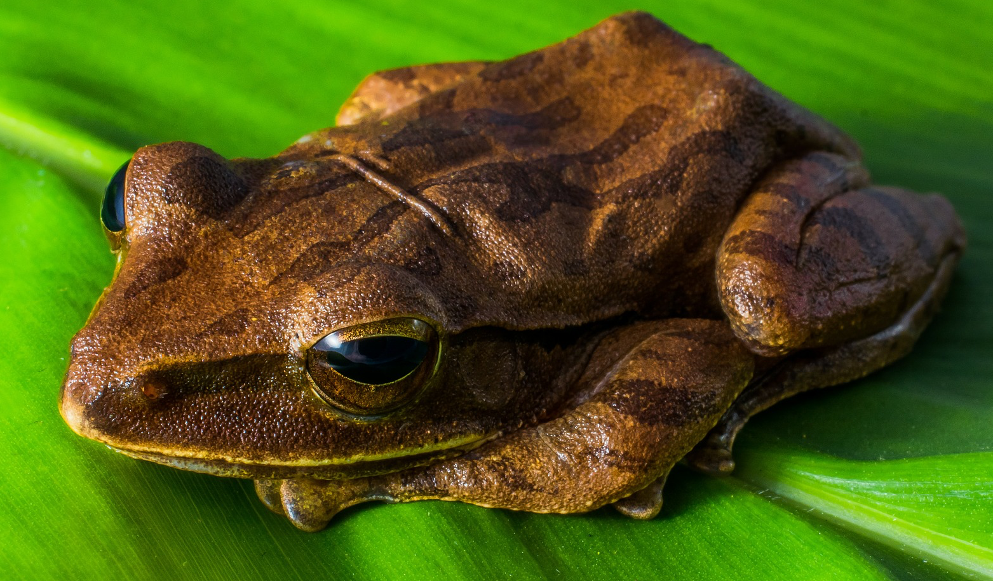
?

Slide 11
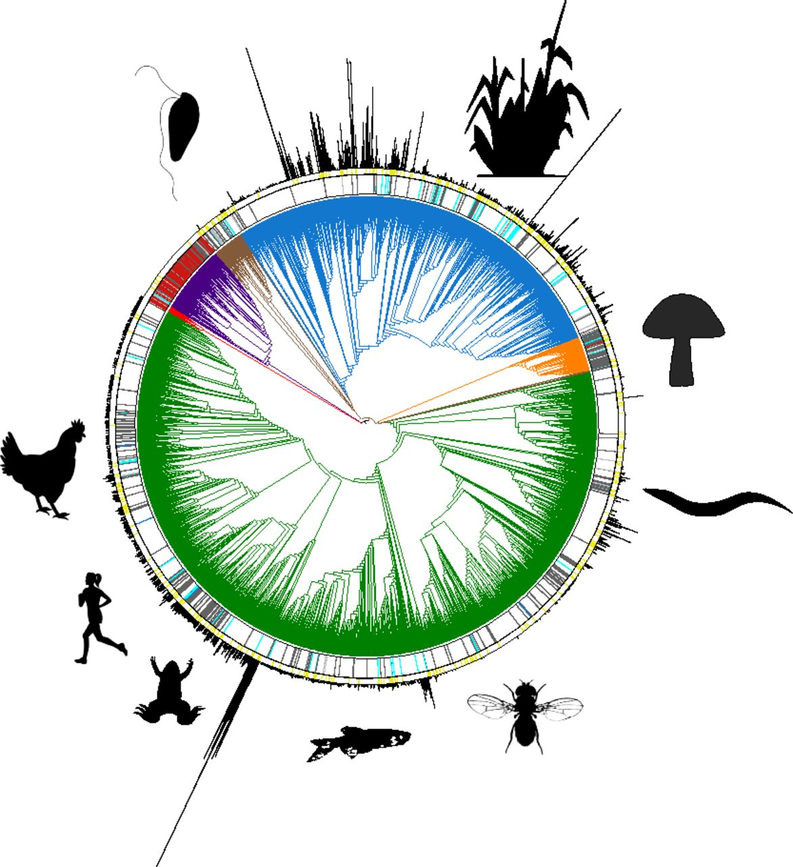

Current status of the sequencing of life.
Earth BioGenome Project (EBP), a moonshot for biology that aims to sequence, catalog, and characterize the genomes of all of Earth’s eukaryotic biodiversity over a period of 10 years.
Harris A. Lewin et al. PNAS 2018;115:17:4325-4333
©2018 by National Academy of Sciences

Slide 12

Genomics Unites Human Biomedicine and Wildlife Research
Biomedical Advances in Humans
Computer Technology
Whole Genome Annotation
Bioinformatic Tools
Transcriptomics, Proteomics
Next Gen Sequencing
Individualized Medicine
Natural Experiment: Wildlife
Speciation
Biodiversity & Systematics
Population Genetics & Phylogeography
Genome Evolution
Adaptation & Selection

